Slide 1


Saksham
AI Powered communication solution for disabled
Mentored By-
Bikram Pratim Bhuyan
Presented By-
Utkarsh Gupta
Aradhya Singh
Priyal Gupta
R177219194 500075374
R177219206 500075358
R177219136 500076110

Slide 2
Contents
Introduction
Literature Review
Objectives
Methodology
Algorithm
Project Architecture
Use Case
Attained Deliverables
References

Slide 3
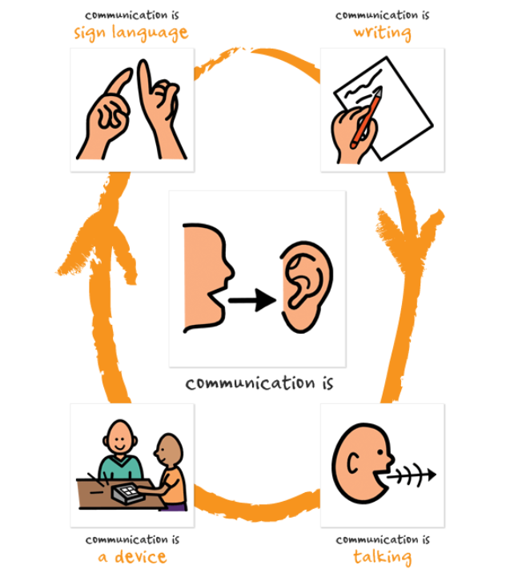
Introduction
Single point solution for communication gap between blind, deaf, mute and normal population. Application is able to convert sign language, voice, braille & text to each other which enables almost everyone to be able to communicate with anyone. The sign language recognition will be achieved through computer vision, voice recognition will be achieved by DNN, braille will be achieved by a sophisticated wireless hardware.

Slide 4
Literature Review
Sign Language to Text and Speech Translation in Real Time Using Convolutional Neural Network
DRISHYAM: Real-Time Text to Braille Conversion and Realization
Efficient Kinect Sensor-based Kurdish Sign Language Recognition Using Echo System Network
Grad-TTS: A Diffusion Probabilistic Model for Text-to-Speech
AN ADVANCED BRAILLE SYSTEM-COMMUNICATION DEVICE FOR BLIND-DEAF PEOPLE
VOICE RECOGNITION SYSTEM: SPEECH-TO-TEXT

Slide 5
Objective
To develop remote communication software accessible to normal, blind, dumb and deaf people, and construct hardware i.e., an interactive, wireless refreshable Braille device that would be connected to the software to facilitate communication for blind people.

Slide 6
Methodology
Developing AI models
Development of user interface
1. Text to Speech 2. Speech to Text 3. Sign Language to Text
Construction of Hardware
Setting up the server
1. Braille to Text 2. Text to Braille

Slide 7
Algorithm
Text
Sign Language
Sign Language
Braille
Voice
Braille
Voice
Login
Select Input/Output Method
InputEngine = InputMethod
OutputEngine = OutputMethod
Get InputMessage
POST InputMessage to localhost:4000
TextMessage = InputEngine(InputMessage)
OutputMessage = OutputEngine(TextMessage)
POST OutputMessage to localhost:3000
Display OutputMessage

Slide 8
Project Architecture
Database
Server
PC
PC
Hardware
Hardware

Slide 9
Server
The server will handle the messages sent from messaging app and all the translations. Most importantly it will be responsible for sign language recognition.

Slide 10
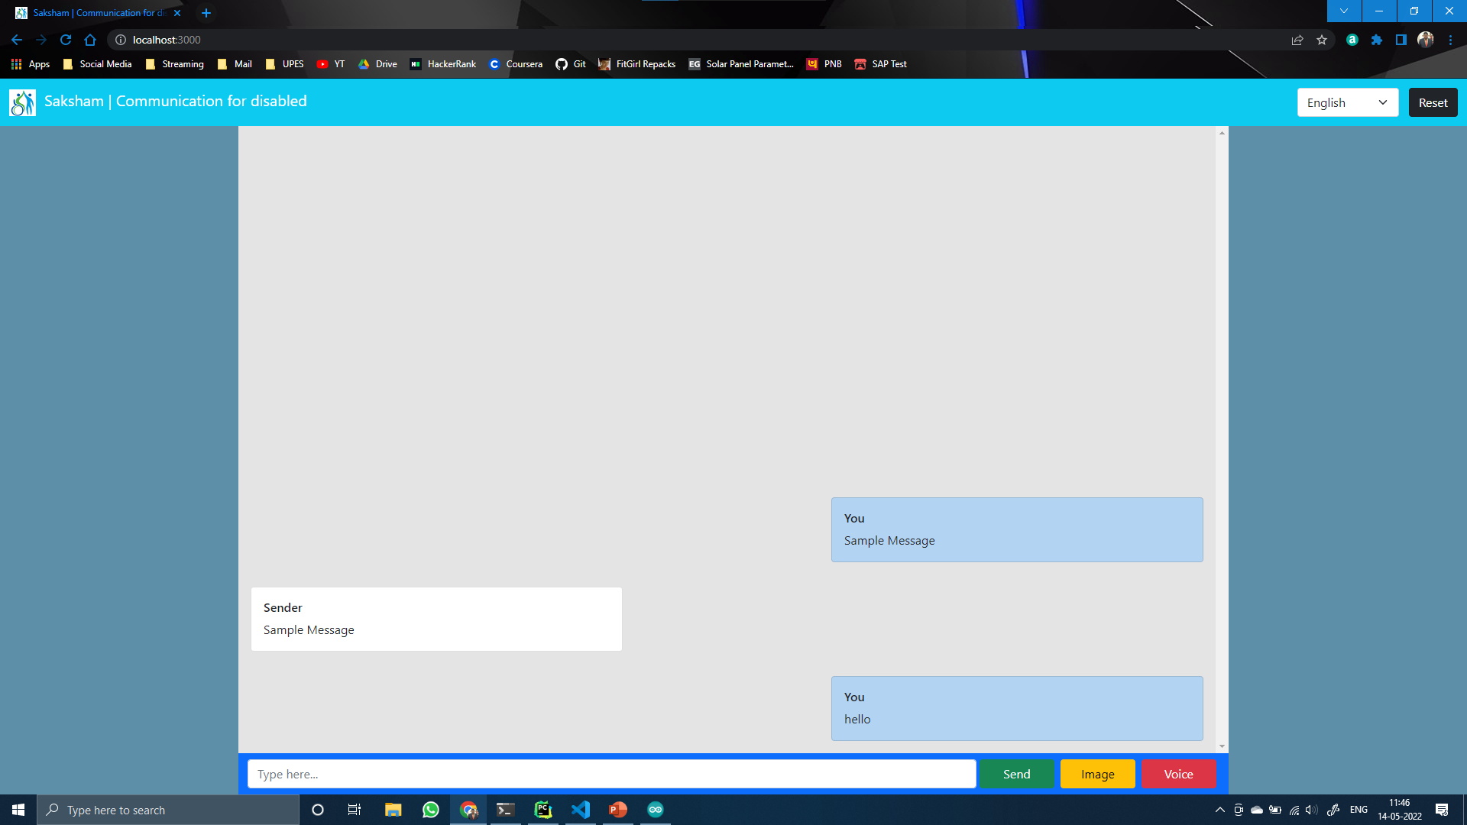
Front End (GUI)

Slide 11
Hardware
The objective of hardware is to enable a person to read and write scripts in braille language through physical touch.

Slide 12
Circuit Diagram
Bluetooth Module HC05
Input Buttons
Arduino Uno
Output Servo/Actuator

Slide 13
Proposed Expenditure
Items | Cost | Quantity | Value
Arduino Uno | 1000 | 2 | 2000
Bluetooth HC05 | 500 | 2 | 1000
Actuator/Servo | 2000 | 12 | 24000
Buttons | 100 | 16 | 1600
PCB Board | 1000 | 2 | 2000
Scaffolding | 500 | - | 500
Total | - | - | 31,100

Slide 14
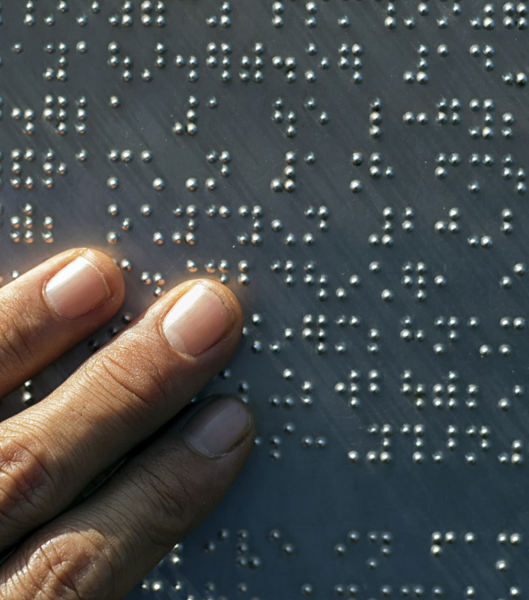
Use Case
Let us consider a use case where a blind person needs to talk to deaf person. Blind doesn’t know sign language & deaf doesn’t know braille
Another case where a normal person needs to talk to a deaf person.

Slide 15
Attained Deliverables
Text to speech engine
Speech to text engine
Graphical User Interface
Written in JavaScript.
Written in JavaScript
Written in HTML, CSS, JS
React Framework is used.
Hardware
Development of circuit.
Programming the device.

Slide 16
[1] Ankit Ojha, Ayush Pandey, Shubham Maurya, Abhishek Thakur, Dr. Dayananda P 2020. Sign Language to Text and Speech Translation in Real Time Using Convolutional Neural Network [2] Mirza, S. F., & Al-Talabani, A. K. (2021). Efficient Kinect Sensor-based Kurdish Sign Language Recognition Using Echo System Network. [3] Y. Neeraja,D.Susritha Reddy, J.Kalpana, K.Subhasri, D. Lokesh 2021, AN ADVANCED BRAILLE SYSTEM-COMMUNICATION DEVICE FOR BLIND-DEAF PEOPLE [4] Himanshu Gautam, Prerna Gaur 2020, DRISHYAM: Real-Time Text to Braille Conversion and Realization [5] Vadim Popov, Ivan Vovk, Vladimir Gogoryan, Tasnima Sadekova, Mikhail Kudinov 2021. Grad-TTS: A Diffusion Probabilistic Model for Text-to-Speech [6] Prerana Das, Kakali Acharjee, Pranab Das and Vijay Prasad 2015, VOICE RECOGNITION SYSTEM: SPEECH-TO-TEXT [7] World Report on Disability [8] Census of India, 2001 [9] https://censusindia.gov.in/census_and_you/disabled_population.aspx
References

Slide 17

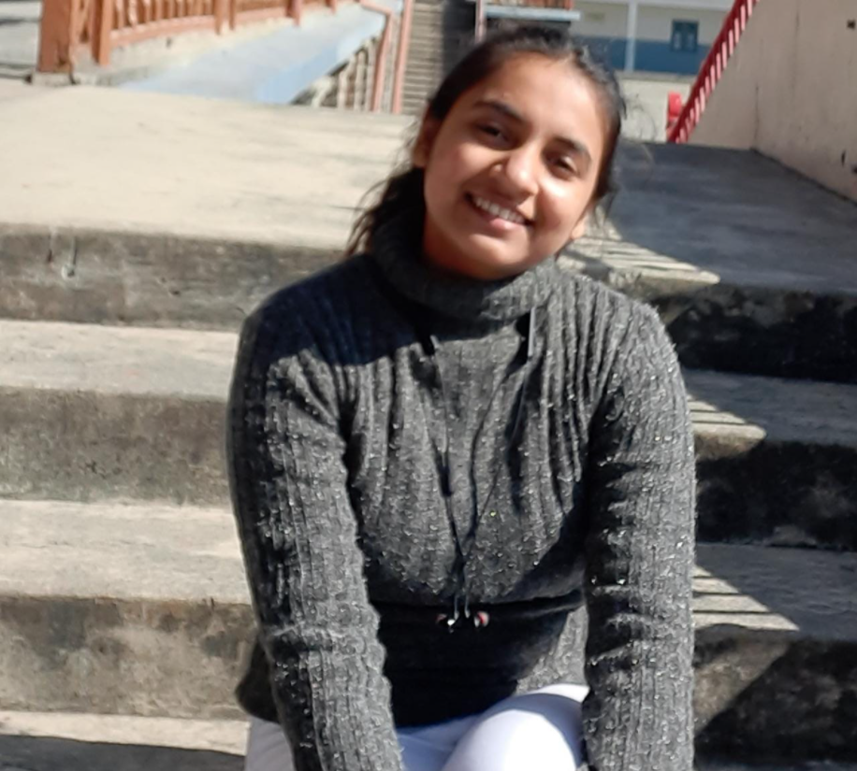
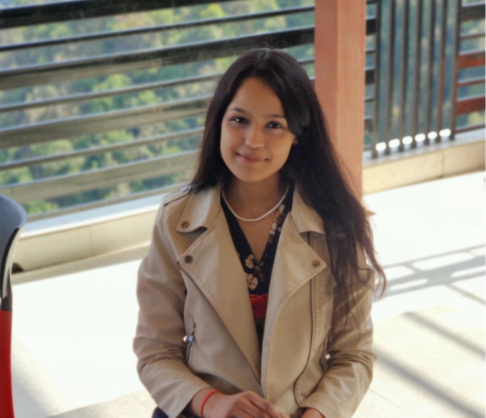
Our team
Utkarsh Gupta
Aradhya Singh
Priyal Gupta
R177219194 500075374@stu.upes.ac.in B. Tech CSE AI&ML B6
R177219200 500075358@stu.upes.ac.in B. Tech CSE AI&ML B6
R177219136 500076110@stu.upes.ac.in B. Tech CSE AI&ML B6

Slide 18
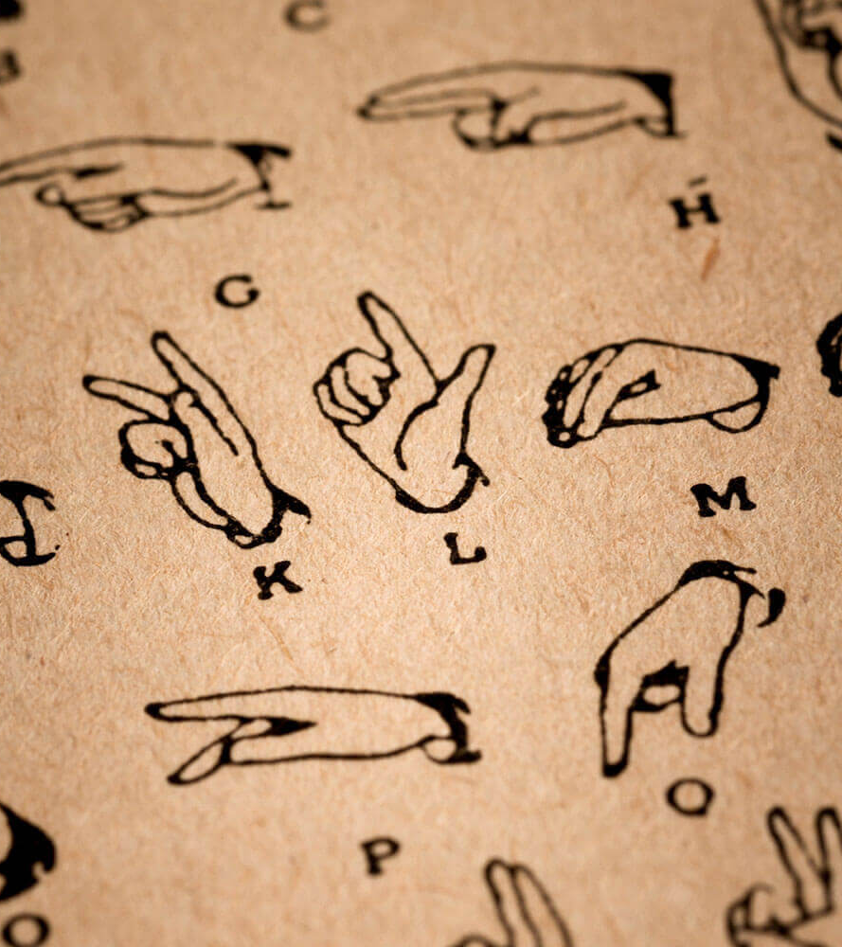
Thank you

